Slide 1

Vision Based Accident Detection System for Smart City

Slide 2
Team Members
Under Guidance
of
Dr.Joyeeta Singha
Anmol Tuli - 20UEC023
Ashish Raj - 20UCC024
Yash Gaur - 20UEC149

Slide 3
CONTENT
INTRODUCTION
CNN MODEL
SHORTCOMING & SOLUTIONS
COMPARATIVE ANALYSIS
LITERATURE
REVIEW
MOBILENET-v2 MODEL
VGG19-SPINALNET BASED MODEL
3

Slide 4

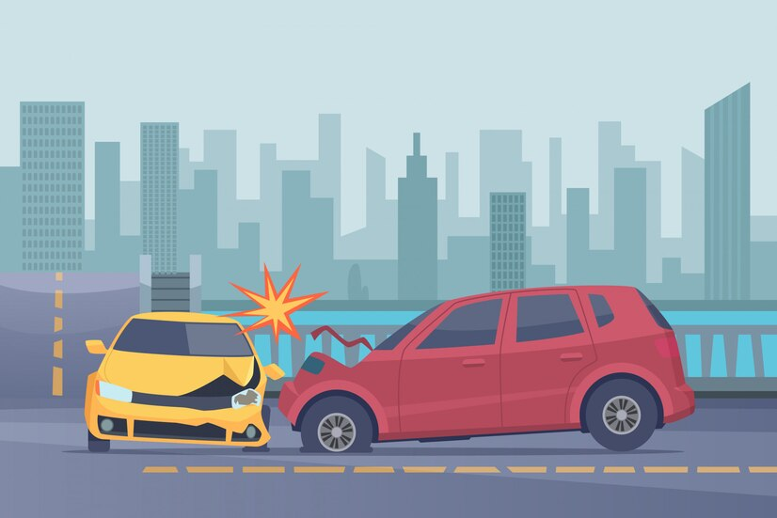
INTRODUCTION

Slide 5
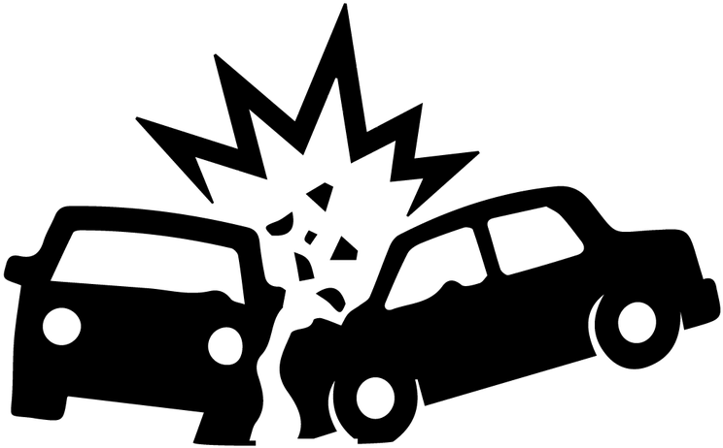
PROBLEM:
Accidents : Major cause of deaths in India,
India's road accidents claim 150,000 lives yearly;
18 deaths/hour.
India at risk of highest road accident fatalities.
5

Slide 6
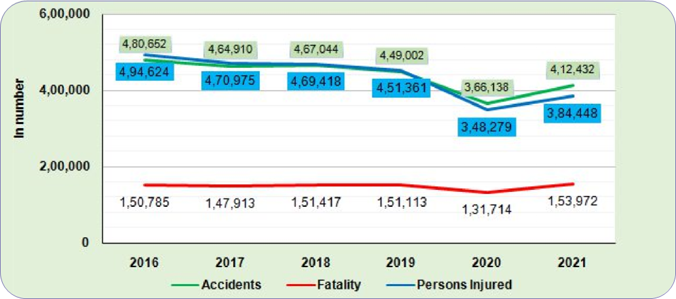
Trends in number of Accidents, Fatalities and Persons Injured:
2016 to 2021
Source : Ministry of Road Transport and Highways
6

Slide 7

LITERATURE REVIEW

Slide 8
Accident Detection using Convolutional Neural Networks [1]
The proposed model is a fusion of CNN and LSTM layers for continuous video classification taken from a camera.
In a CNN-LSTM network, the CNN is primarily used for feature extraction from the images, which is passed on to the LSTM for sequence prediction.
Accuracy: The paper reports an overall accuracy of 92.38% for the accident detection task.
Pros: The use of convolutional neural networks (CNNs) can improve the accuracy of the model in detecting accidents.
Cons: The paper does not provide information on the model's performance in detecting specific types of accidents or in different weather or lighting conditions.
8

Slide 9
CNN Based Accident Detection , AI Based Support System [2]
The system uses Deep Learning with CNN to predict accident severity.
It covers data collection, preprocessing, model building, training, validation, and deployment phases.
The systematic steps for implementing supervised machine learning algorithms include convolution, max pooling, activation functions, model validation, and model deployment.
The proposed architecture is scalable for retraining and can predict both accident occurrence and severity in a single model.
Accident pictures are immediately shared with stakeholders through email or other communication methods.
9

Slide 10
Automatic driver distraction detection using deep convolutional neural networks [3].
The proposed model uses the concept of transfer learning for high-level features from raw input images taken from a camera.
Convolutional Neural Network: Different CNN architectures such as ResNet50, VGG16, and MobileNetV2 are incorporated in the distracted driving detection model to automatically extract high-level features from raw input images
Classification: CNN uses its learned experience from previous phases to identify the specific distracted behavior.
The CNN-based driver distraction detection system has limitations such as limited datasets and high computational requirements.
10

Slide 11
SpinalNet: Deep Neural Network With Gradual Input [4]
The research paper introduces SpinalNet, a neural network inspired by the human spinal cord architecture, featuring input, intermediate, and output splits in each layer.
The paper reports an overall accuracy of 90.97 percent on average and a best accuracy of 91.47 percent.
Pros:SpinalNet addresses computational intensity issues by gradually processing inputs, making it less resource-intensive than traditional models.
Cons:It requires accuracy improvement for diverse datasets, necessitating further research and experimentation.
11

Slide 12
Transfer learning for image classifcation using VGG19 [5]
The research paper combines VGG19 with handcrafted feature extraction algorithms to enhance image classification accuracy.
VGG19, a 19-layer convolutional neural network, is employed for deep feature extraction, utilizing 3×3 filters and 16 convolutional layers trained on ImageNet.
The paper highlights the need for dimensionality reduction to manage the substantial parameters and concludes with a classification method.
Accuracy: The proposed hybrid model achieves a notable 91.8% accuracy on the CIFAR-10 dataset.
12

Slide 13
DATASET:
The dataset used in the model has been comprehensively prepared by our team to train and evaluate our model .
We have extracted the frames from the videos used in the dataset of “ Unsupervised Traffic Accident Detection in First-Person Videos.”
Procedure:
Downloaded the available video dataset of you tube videos -> youtube-dl.
Extracted frames from the videos -> ffmpeg.
Manually labelled the frames.
ImageDataGenerator class from Keras to apply data augmentation techniques to the images.
13

Slide 14
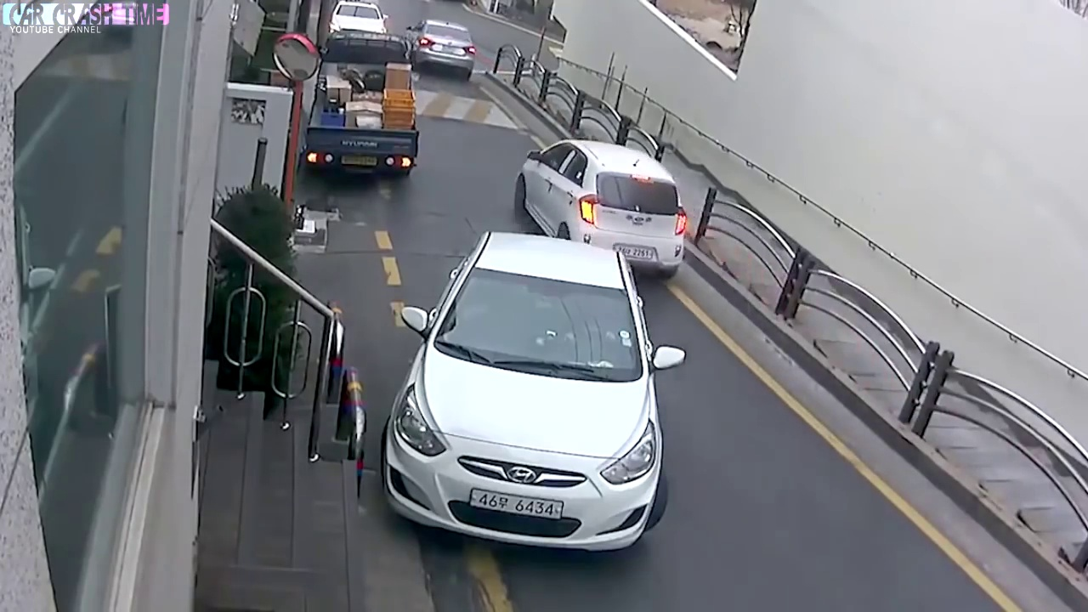
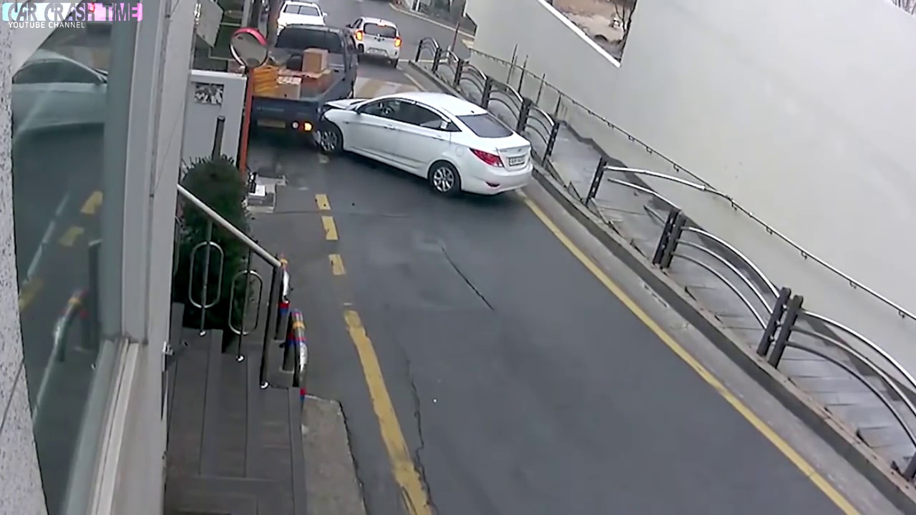
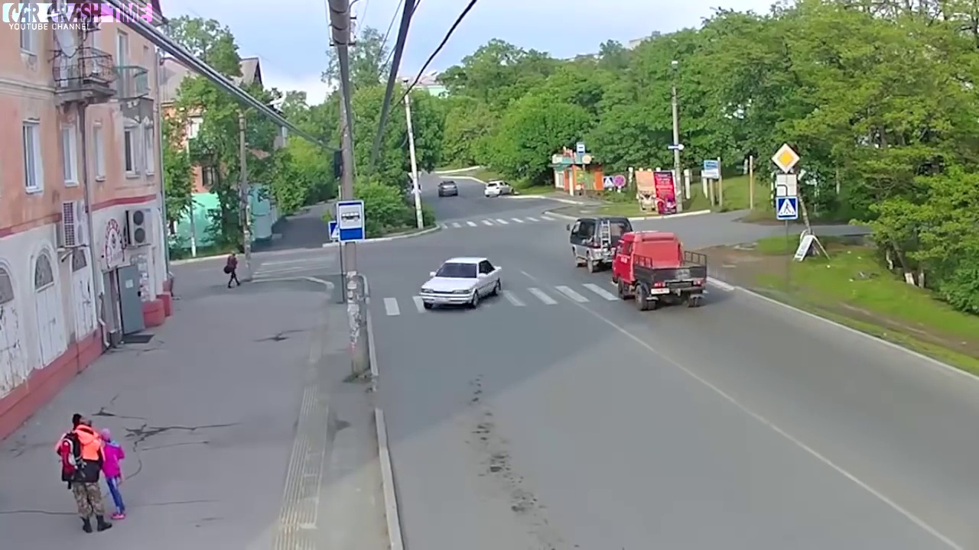
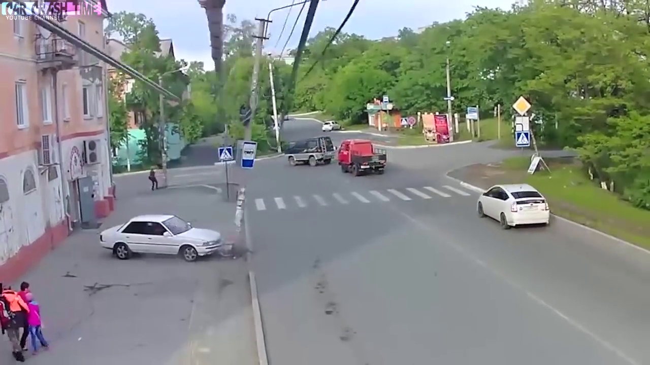
Training Data (Images) | Testing Data(Images)
Accident : 422 | Accident : 47
Non-Accident :369 | Non-Accident : 54
Validation Data : (Images) 98
Non-Accident Accident
14

Slide 15

ACCIDENT DETECTION SYSTEM BASED ON CNN & MOBILENETV2

Slide 16
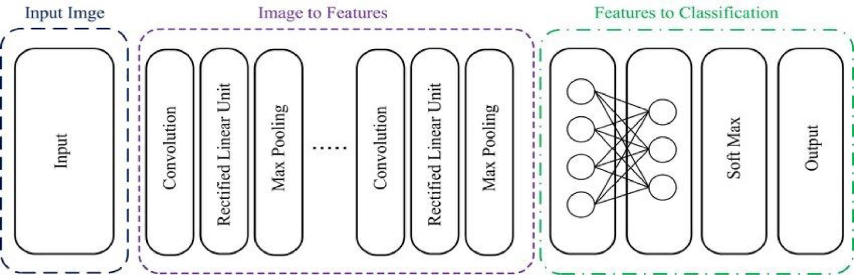
Convolutional Neural Network
CNNs are deep neural networks trained on raw images to automatically extract high-level features for image classification, object detection, and segmentation.
Architecture of Convolutional Neural Network.
Source:Hossain, Md Uzzol, Md Ataur Rahman, Md Manowarul Islam, Arnisha Akhter, Md Ashraf Uddin, and Bikash Kumar Paul. "Automatic driver distraction detection using deep convolutional neural networks." Intelligent Systems with Applications 14 (2022): 200075.
16

Slide 17
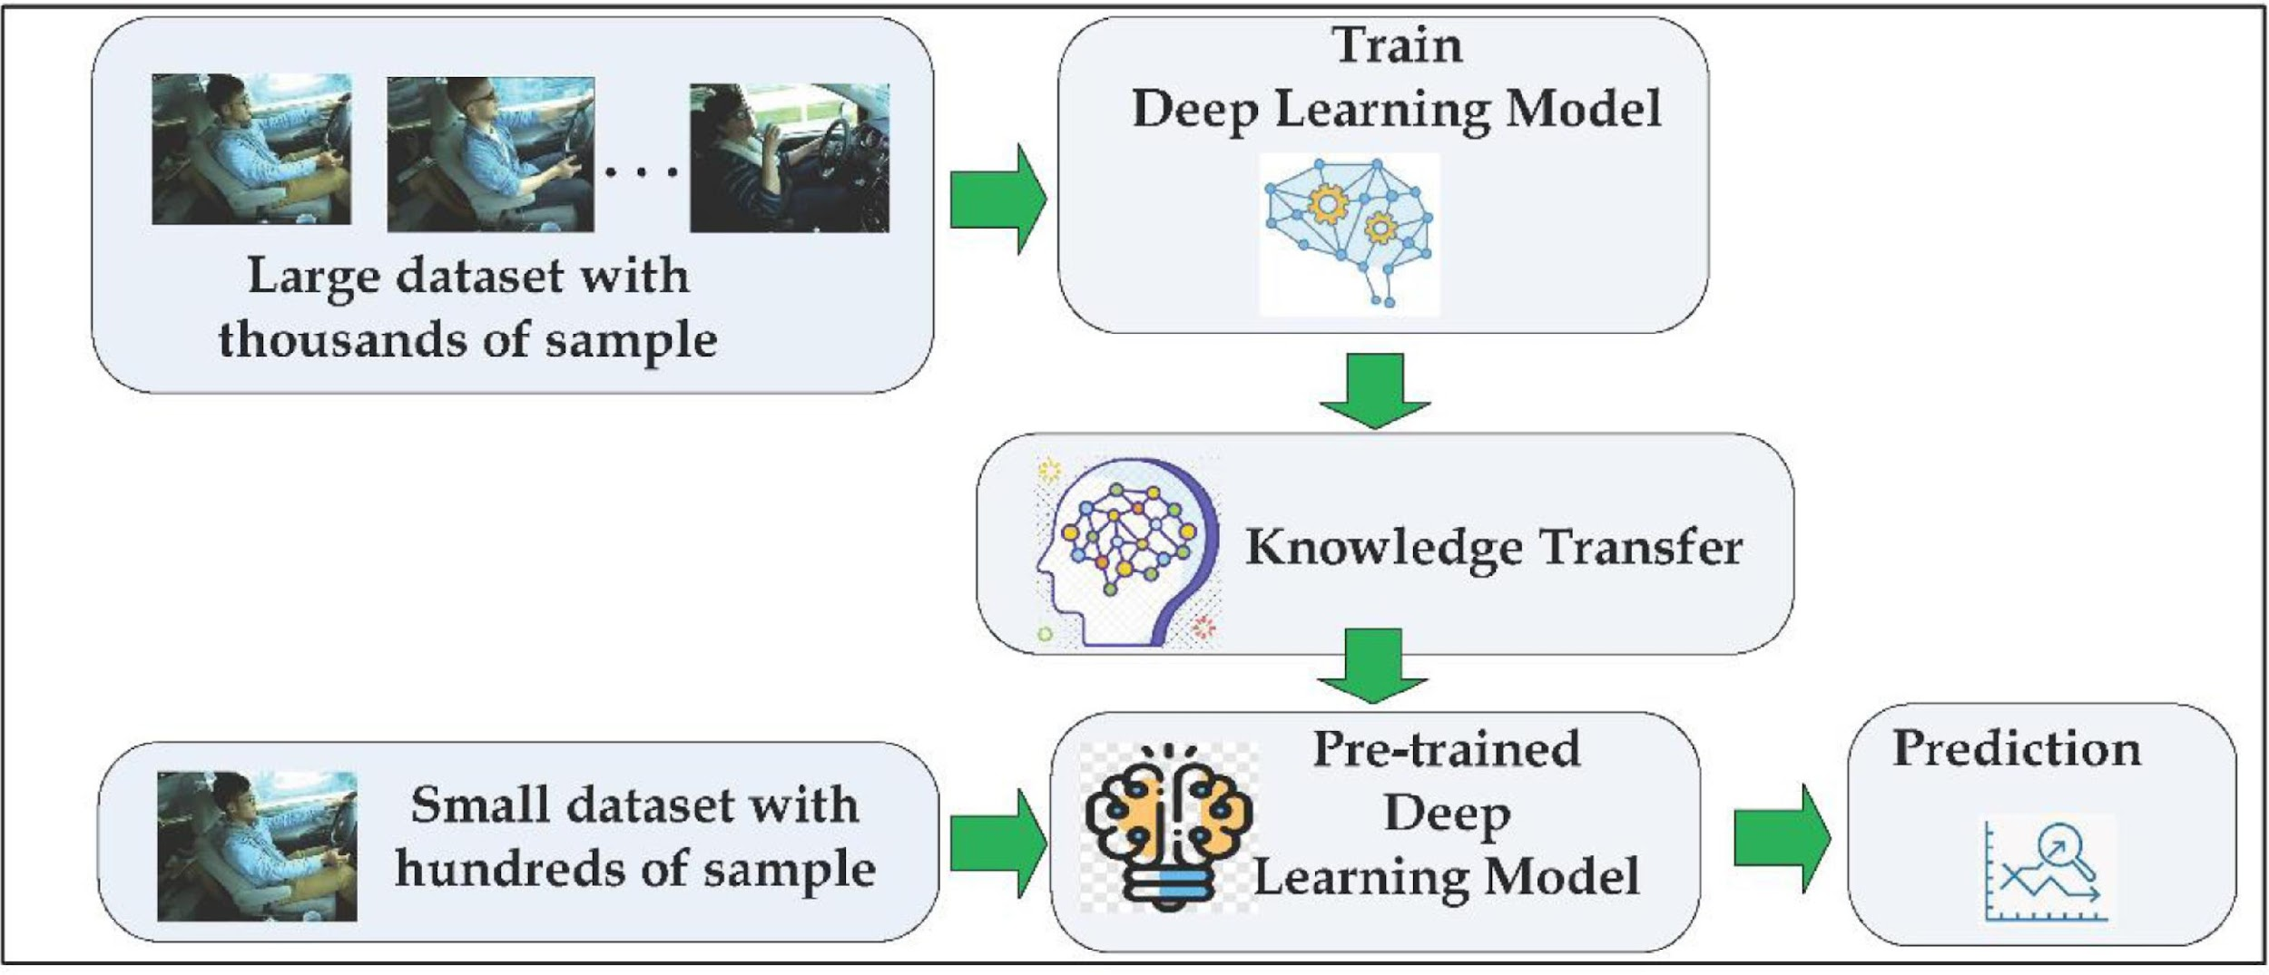
Pre-trained model transfer learning:
Transfer learning uses pre-trained model features to fine-tune a new model for a specific task on a new dataset.
Pre-trained CNN models use learned low-level features from large image datasets to extract deep features from new images.
CNN-based architecture adopted for deep feature extraction: MobileNetV2.
Basics of transfer learning.
Source : Hossain, Md Uzzol, Md Ataur Rahman, Md Manowarul Islam, Arnisha Akhter, Md Ashraf Uddin, and Bikash Kumar Paul. "Automatic driver distraction detection using deep convolutional neural networks." Intelligent Systems with Applications 14 (2022): 200075.
17

Slide 18

SUMMARY OF THE RESULTS:
CNN model: 74.9% accuracy , overfit, model complexity.
Transfer learning: Pre-trained feature extractor on Imagenet dataset, boosted accuracy from 74 % to 89.8%.
Mobilenet-V2: Powerful base model followed by relatively shallow layers, 89.8% accuracy ceiling.
Augmenting the dataset can further increase accuracy.
18

Slide 19

Shortcomings Of Implemented Models & Possible Solutions

Slide 20
Challenge | Solution
Data Limitations | Use Data Augmentation to diversify the training set and improve generalization to unseen examples.
Limited Model Adaptation | Fine-Tune specific MobileNetV2 layers on the target dataset,experimenting with selective layer training.
Overfitting Risk | Mitigate overfitting by introducing regularization techniques, such as Dropout Layers, and monitor performance on a validation set.
Challenge | Solution
Data Limitations
20

Slide 21
Challenge | Solution
Learning Rate | Experiment with different Learning rates to find the optimal balance between convergence speed and avoiding overshooting.
Model Complexity | Evaluate and adjust the model's complexity by adding layers or increasing units based on the dataset's requirements.
Hyperparameter Tuning | Explore diverse hyperparameter configurations, including Batch size, Epochs, and layer settings, to maximize performance on training and validation sets.
Challenge | Solution
Data Limitations
21

Slide 22
ACCIDENT DETECTION SYSTEM BASED ON VGG 19 WITH SPINALNET ARCHITECTURE

Slide 23
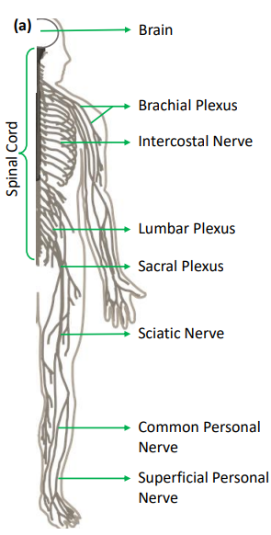
SpinalNet Architecture
DNN Challenge Resolution:
Vanishing Gradient Mitigation
Optimized Computational Efficiency
Proposed SpinalNet :
Inspiration from the efficient processing of diverse tactile information in the Human Somatosensory System, mimicking the spinal architecture.
1.Gradual input
2.Local output and probable global influence
3.Weights reconfigured during training
Structure of spinal cord
Source:H. D. Kabir, M. Abdar, A. Khosravi, S. M. J. Jalali, A. F. Atiya, S. Nahavandi, and D. Srinivasan, “Spinalnet: Deep neural network with gradual input,” IEEE Transactions on Artificial Intelligence, 2022. .
23

Slide 24
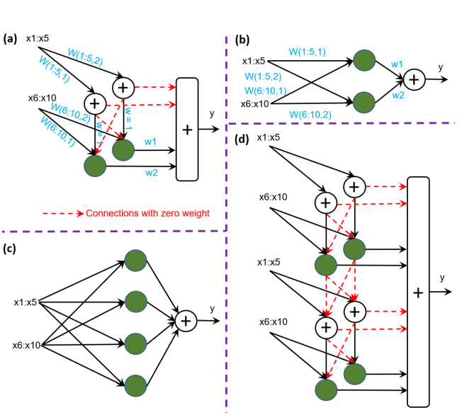
SpinalNet Architecture: With input, intermediate, and output layers, SpinalNet processes inputs gradually, reflecting human sensory neuron tuning.
Activation Functions: Nonlinear activation in intermediate layers and linear in output enhance information processing.
Visual Proof: Comparing SpinalNet to a wide single hidden layer network visually proves its universal approximability.
Deep SpinalNet: SpinalNet maintains universal approximability, representing complex relations with fewer neurons when certain weights are not frozen.
Visual structure of SpinalNet Architecture
Source:H. D. Kabir, M. Abdar, A. Khosravi, S. M. J. Jalali, A. F. Atiya, S. Nahavandi, and D. Srinivasan, “Spinalnet: Deep neural network with gradual input,” IEEE Transactions on Artificial Intelligence, 2022. .
24

Slide 25
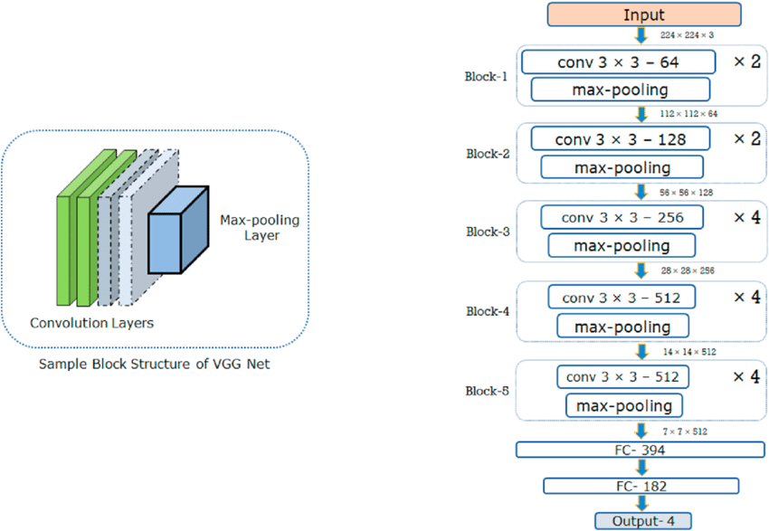
VGG19
VGG-19 Architecture: 19-layer CNN for image classification with 3x3 filters.
Block Setup: Five blocks, combining convolutional and max-pooling layers.
Feature Hierarchy: Convolutional layers capture hierarchical features.
Prediction Layers: Final fully connected layers for image predictions.
Sample Block and Fine tuned Architecture of VGG-19
Source: Sudha, V. & Ganeshbabu, Dr. (2020). A Convolutional Neural Network Classifier VGG-19 Architecture for Lesion Detection and Grading in Diabetic Retinopathy Based on Deep Learning. Computers, Materials & Continua. 66. 827-842. 10.32604/cmc.2020.012008.
25

Slide 26
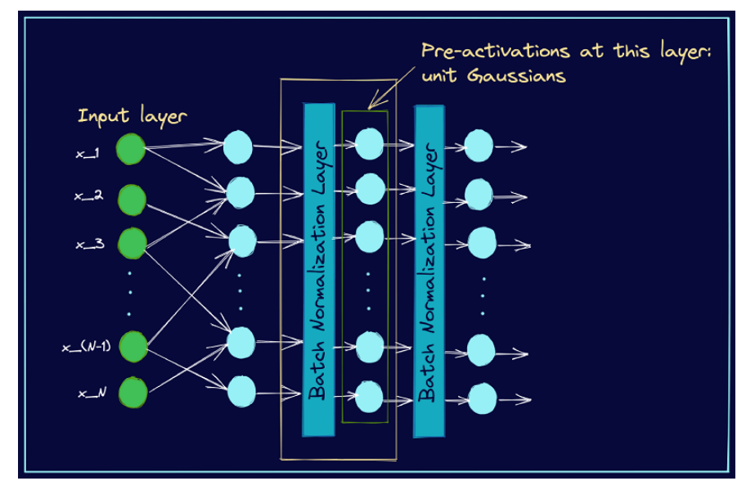
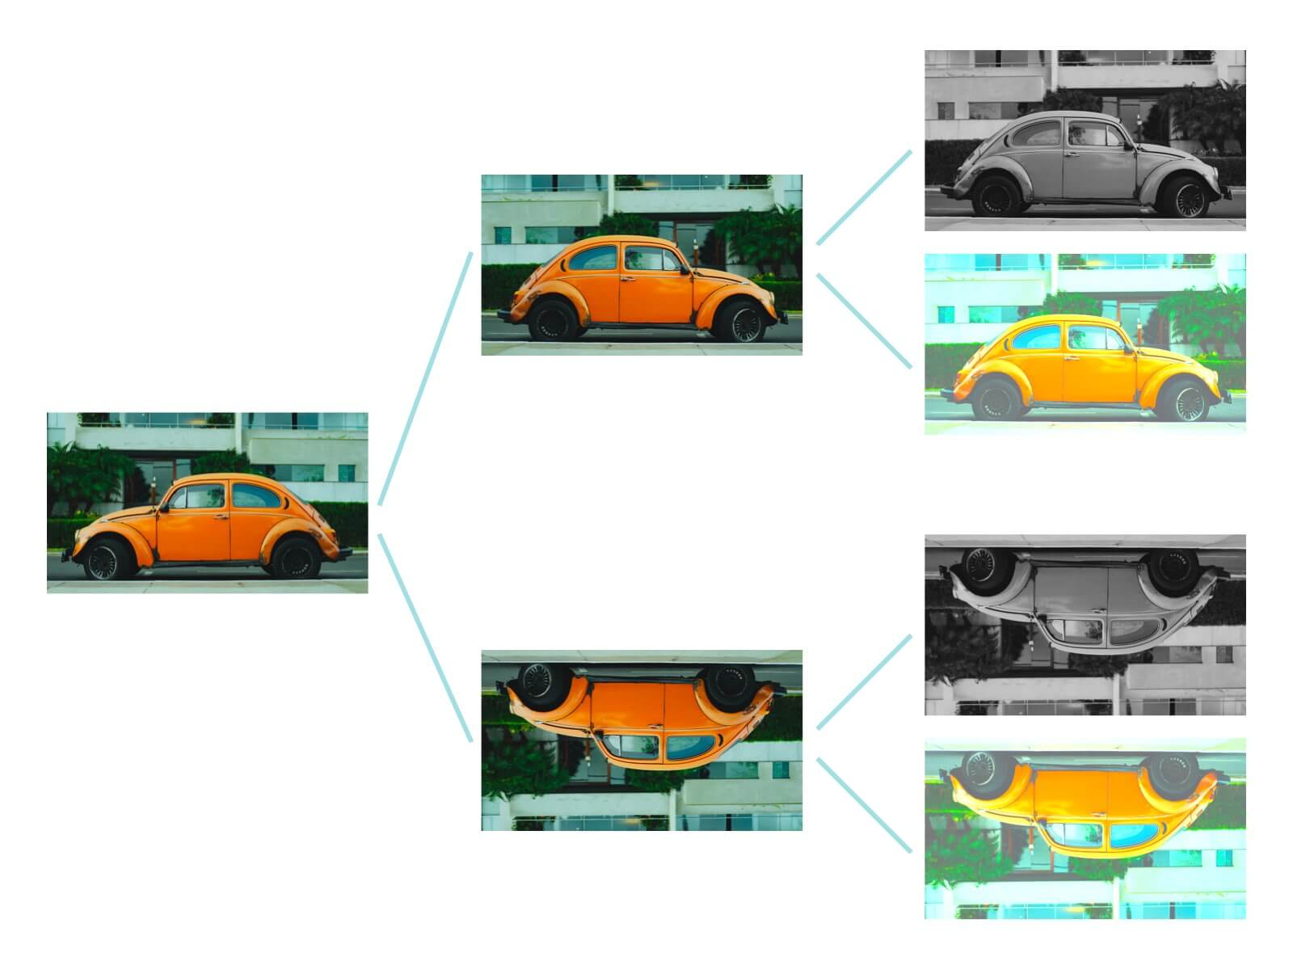
DATA PREPROCESSING
BATCH NORMALIZATION
DATA AUGMENTATION
Seamless Integration
Normalization after Fully Connected Layers
Stabilizing Convolutional Layers
Rotation : (Variability)
Horizontal Flip : (Symmetry)
Image Resizing : (Consistency)
Source: ht H. D. Kabir, M. Abdar, A. Khosravi, S. M. J. Jalali, A. F. Atiya, S. Nahavandi, and D. Srinivasan, “Spinalnet: Deep neural network with gradual input,” IEEE Transactions on Artificial Intelligence, 2022. /
26

Slide 27


RESULTS & COMPARATIVE ANALYSIS

Slide 28


Slide 29
COMPARATIVE ANALYSIS
Aspect | CNN-Based Model | MobileNetV2- Based Model | VGG19-Based SpinalNet Model
Accuracy (%) | 74.9 | 89.8 | 96
Model Choices |  | Better feature extraction due to pre-training on a large dataset. | Deep architecture and integrated with SpinalNet architecture to improve accuracy.
Model Size and Complexity |  | Lightweight compared to VGG19. | Larger number of parameters compared to MobileNetV2.
29

Slide 30
Aspect | CNN-Based Model | MobileNetV2- Based Model | VGG19-Based SpinalNet Model
Fine-Tuning Pre-trained Layers | Custom CNN | MobileNetV2's pre-trained layers used. | VGG19 pre-trained layers are frozen, and SpinalNet layers are fine-tuned.
Selective Training of Layers |  | Adapted pre-trained layers to the target dataset characteristics without overfitting. | Selectively trained certain layers, balancing adaptation to the task and leveraging pre-trained features.
Conclusion | Enhanced over basic CNN lacks explicit pre-trained layer utilization. | Demonstrates better accuracy than the CNN-Based Model, leveraging MobileNetV2's feature extraction. | Highest accuracy, integrating VGG19 with the SpinalNet architecture.
30

Slide 31

Conclusion
&
Future Work

Slide 32
The SpinalNetV2 model achieved the highest accuracy (95.9184 percent), surpassing both the CNN(74.9 percent) and MobileNetV2 model.(89.80 percent)
Integration with traffic management systems allows prompt issue response, rerouting, and congestion mitigation.
Provides insights into traffic patterns and accident-prone areas, enhancing overall urban safety.
Deploying the project as an Android app for accessibility and expanding models for enhanced accident detection in smart cities.
32

Slide 33
References:
Ghosh, Sreyan, Sherwin Joseph Sunny, and Rohan Roney. "Accident detection using convolutional neural networks." In 2019 International Conference on Data Science and Communication (IconDSC), pp. 1-6. IEEE, 2019.
Tamagusko, Tiago, Matheus Gomes Correia, Minh Anh Huynh, and Adelino Ferreira. "Deep learning applied to road accident detection with transfer learning and synthetic images." Transportation research procedia 64 (2022): 90-97.
Choi, Jae Gyeong, Chan Woo Kong, and Sunghoon Lim. "A Review of AI-based Automobile Accident Prevention Systems." Journal of the Korea Safety Management & Science 22, no. 1 (2020): 9-14.
Hossain, Md Uzzol, Md Ataur Rahman, Md Manowarul Islam, Arnisha Akhter, Md Ashraf Uddin, and Bikash Kumar Paul. "Automatic driver distraction detection using deep convolutional neural networks." Intelligent Systems with Applications 14 (2022): 200075.
M. of Road Transport and G. o. I. Highways, “Road accident in india- 2021,” 2022.
H. D. Kabir, M. Abdar, A. Khosravi, S. M. J. Jalali, A. F. Atiya, S. Nahavandi, and D. Srinivasan, “Spinalnet: Deep neural network with gradual input,” IEEE Transactions on Artificial Intelligence, 2022. .
Source : Bhatti, Fizzah, Munam Ali Shah, Carsten Maple, and Saif Ul Islam. "A novel internet of things-enabled accident detection and reporting system for smart city environments." sensors 19, no. 9 (2019): 2071
Sudha, V. & Ganeshbabu, Dr. (2020). A Convolutional Neural Network Classifier VGG-19 Architecture for Lesion Detection and Grading in Diabetic Retinopathy Based on Deep Learning. Computers, Materials & Continua. 66. 827-842. 10.32604/cmc.2020.012008.
Buiu, Cătălin, Vlad-Rareş Dănăilă, and Cristina Nicoleta Răduţă. "MobileNetV2 ensemble for cervical precancerous lesions classification." Processes 8, no. 5 (2020): 595.
33

Slide 34


